Slide 1
Air Quality India

Slide 2
Summary
Vendor | History Data From | Fields Available | Data Quality | Comments | API
OpenWeatherMap | 24th Nov 2020 ( Hourly) | CO,NO,NO2,O3,SO2,PM2_5,PM10,NH3 | Continuous Data available |  | City Wise API based on Lat and Lng
Weatherbit.io | 13th Jan 2022 | PM 2.5, PM 10, CO, SO2, NO2, and O3 | Continuous Data available |  | City Wise API with City name available
Aqicn | Data availability variable. Based on Cities. For ex – Delhi has since 2014, Mumbai has since 2019 | Data availability variable. Based on Cities/ Stations. For ex – Delhi Station 1 has PM2_5 whereas station 2 has O3, PM2_5 etc | Discontinuous Data available. Only AQI is available | Fetches Data from official Sources. | No API, Individual Cities, Stations. For ex: Delhi has 15 stations

Slide 3
Weatherbit.io
https://www.weatherbit.io/api/airquality-history
It returns air quality data on the 6 major surface pollutants - PM 2.5, PM 10, CO, SO2, NO2, and O3. Additionally, this API returns an air quality index score.
For historical, weather data is available for 20 years.
For Air quality data, data from Jan 13th 2022 is available

Slide 4
OpenweatherMap
https://openweathermap.org/api/air-pollution
Historical Data for 2 years is only available. From 2020
Data is consistent and almost no missing values.
Air pollution forecast is available for 5 days with hourly granularity. Historical data is accessible from 27th November 2020.
https://openweathermap.org/accuracy-and-quality

Slide 5
Air Quality Historical Data Platform
https://aqicn.org/data-platform/register/
Contains data for most of the cities. But a lot of data are missing.
Data availability is variable. The parameters, history varies from station to station. For ex – US Embassy Station in Delhi has only PM2.5 data available from 2015, where as ITO station has data since 2014 for PM2.5, PM10,O3 etc
The data is in the form of AQI – Air Quality Index

Slide 6
Other Air Quality Data Platform
IQAIR - https://www.iqair.com
Gives the AQI reading of any place averaged out from all the stations
Have historical data, but not yet fetched

Slide 7
NO2
Comparison

Slide 8
Summary
For NO2 Comparison 3 data sources are used for each city – namely Official, API and Satellite
Official Data is sourced from - Central Control Room for Air Quality Management - All India
API Data is sourced from – OpenWeatherMap.com
Satellite Data is sourced from – OMI
Satellite Data is in the form of molecules/cm^2 – It is transformed to ug/m^3 using a conversion factor of 1.88x10^(-15) (Ref - Remote sensing of exposure to NO2: Satellite versus ground-based measurement in a large urban area )
For the Stations in a particular city, the nearest station to the coordinates obtained for the city is used. If data is insufficient, second/third nearest station is selected

Slide 9
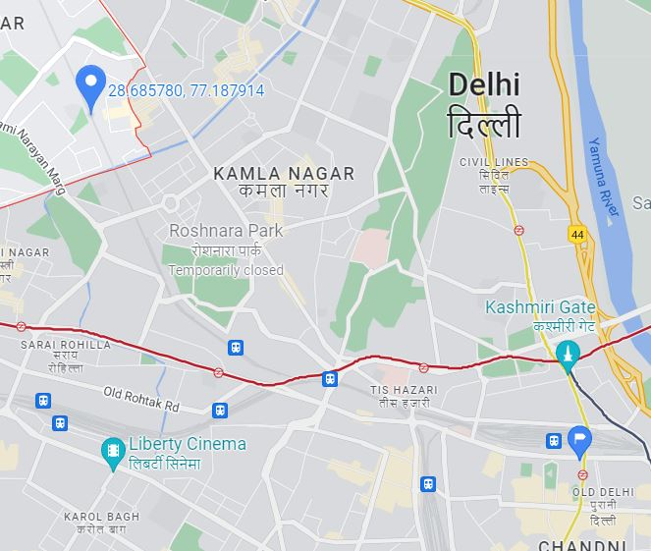
Example of Station Selection
Coordinates of Nearest Station
Coordinates of Delhi (28.662,77.23)

Slide 10
DELHI NO2 Comparison
Station – Ashok Vihar
Official Data available from 2015

Slide 11
Delhi Satellite vs Official (Unnormalized)

Slide 12
Delhi API vs Official

Slide 13
Delhi API vs Satellite

Slide 14
Delhi Official vs Satellite (Normalized)

Slide 15
Summary Stats Delhi
Data Availability
NO2_API | 100%
NO2_Official | 99.71%
NO2_Satellite | 52.05%

Slide 16
MUMBAI NO2
Station - Sion
Official Data available from 2019

Slide 17
Mumbai API vs Official

Slide 18
Mumbai Official vs Satellite

Slide 19
Mumbai API vs Satellite

Slide 20
Summary Stats Mumbai
Data Availability
NO2_API | 100%
NO2_Official | 98.85%
NO2_Satellite | 51.56%

Slide 21
KOLKATA NO2
Station Used - Bidhannagar, Kolkata
Official Data from 2018

Slide 22
Kolkata Official vs Satellite

Slide 23
Kolkata Official vs API

Slide 24
Summary Stats Kolkata
Data Availability
NO2_API | 100%
NO2_Official | 96.11%
NO2_Satellite | 47.67%

Slide 25
Bengaluru NO2
Station - Silk Board
Official Data from 2015

Slide 26
Bengaluru Official vs Satellite

Slide 27
Bengaluru Official vs API

Slide 28
Summary Stats Bengaluru
Data Availability
NO2_API | 100%
NO2_Official | 97.93%
NO2_Satellite | 48.02%

